Slide 1
Hints for Lab 02
Multimeter demo via Doccam
Breadboard set up extra step shown using Doccam

Slide 2
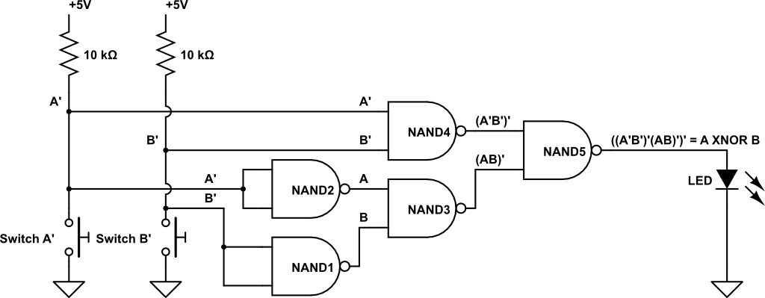
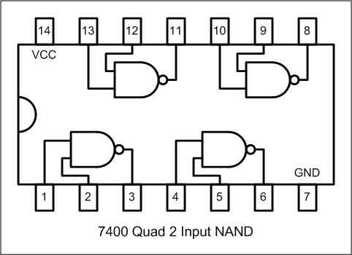
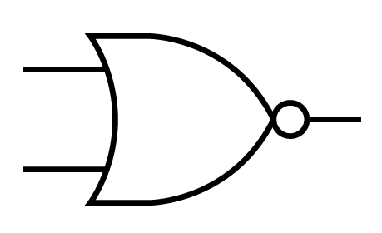
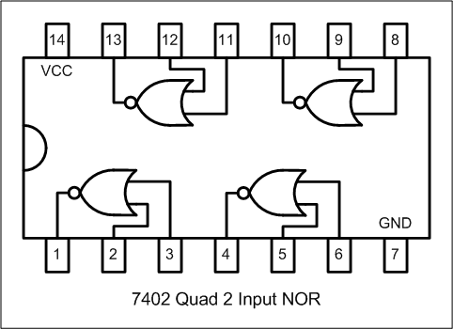
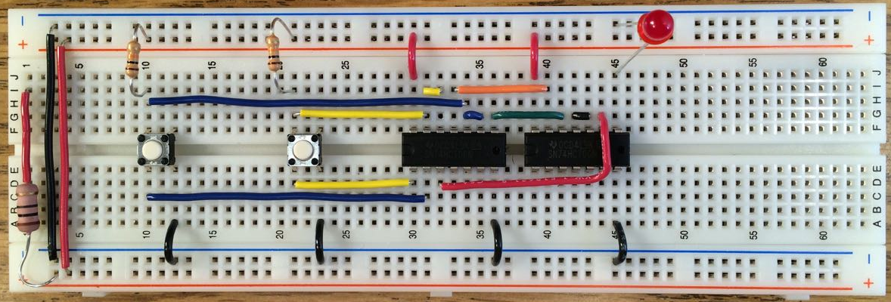
Corresponding schematic and layout
NOR1
NOR2

Slide 3
Lab 02 – build this circuit in-lab
Substitute 2 NOR gates as inverters for the 2 NAND gates as inverters
NOR1
NOR2

